Slide 1
DIFFERENTIATING BTEWEEN HUMAN AND CHATGPT-GENERATED ANSWERS
CORTEXA

Slide 2

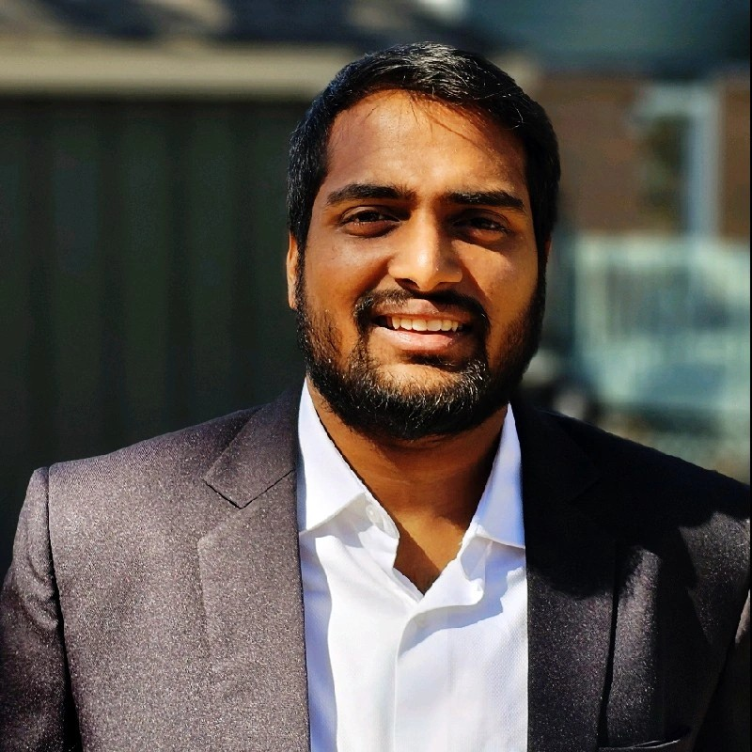


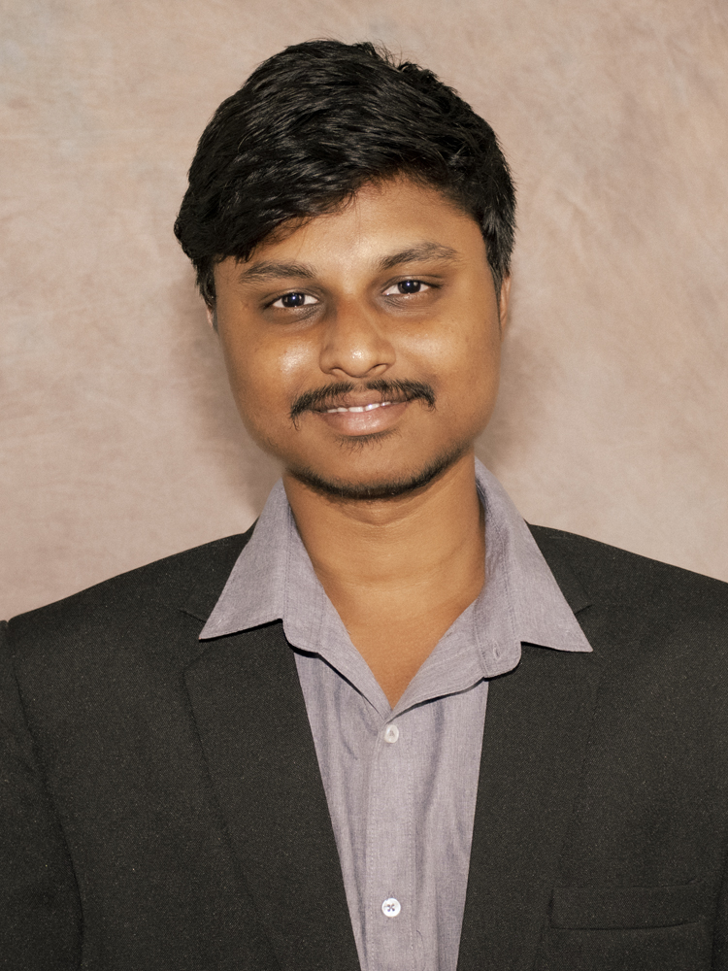
TEAM MEMBERS
Venkata Sai Gagan Deep Alusuri
Sri Kumar Dundigalla
Shashank Rao Gujja
Penchala Akshay Kumar Kandagaddala
Venkata Satya Naveen Nagulapalli

Slide 3
INTRODUCTION
Advanced language models blur the line between human and AI-generated text, creating challenges in academia for verifying the authenticity of student work.
The project focuses on developing a method to distinguish between human and ChatGPT-authored text, particularly for student submissions and communications.
Implementing a reliable detection mechanism is crucial for maintaining the integrity of academic achievements and reflecting true student effort.

Slide 4
BUSINESS PROBLEM
How can we reliably differentiate between human and ChatGPT-generated answers to questions?
What are the implications for educational technology and AI in addressing the challenge of academic dishonesty?
Detection Reliability
Educational Integrity
Dishonesty Prevention

Slide 5
MOTIVATION
THE CHALLENGE
OBJECTIVE
The increasing difficulty of distinguishing between human and AI-generated text.
Escalating use of ChatGPT in educational submissions and email communications.
Develop a robust methodology to safeguard academic integrity.
Address challenges in digital communication by distinguishing between human and AI-generated content.

Slide 6
DATA PREPARATION
Reddit Web Extraction: Collecting diverse data from subreddits: AskAcademia, Anthropology, AskAstrologers, AskCulinary, AskHistorians, Datascience.
2. Hugging Face Pre-trained Model: Utilizing 'Question-vs-Statement Classifier' from Hugging Face (shahrukhx01/question-vs-statement-classifier).
3. Data Exploration and Pre-processing: - Organizing questions and answers into a labeled dataset. - Ensuring the dataset's quality by using a question classifier.
4. Generating Prompts using ChatGPT 3.5 Turbo: - Creating a parallel set of AI-generated responses for analysis.

Slide 7
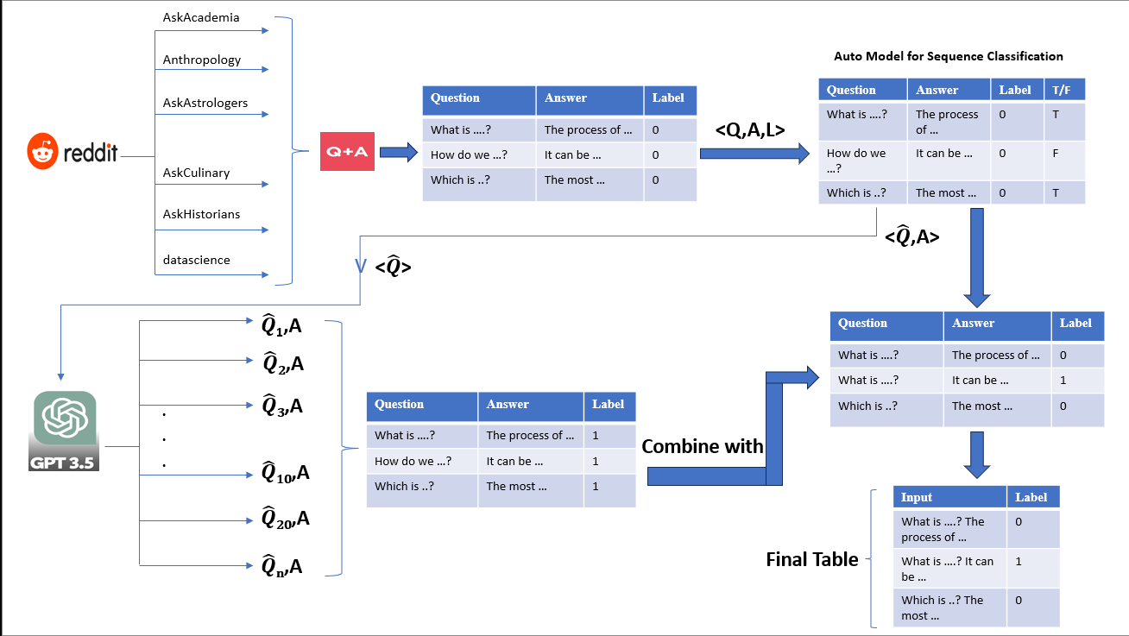
DATA PREPARATION PROCESS

Slide 8
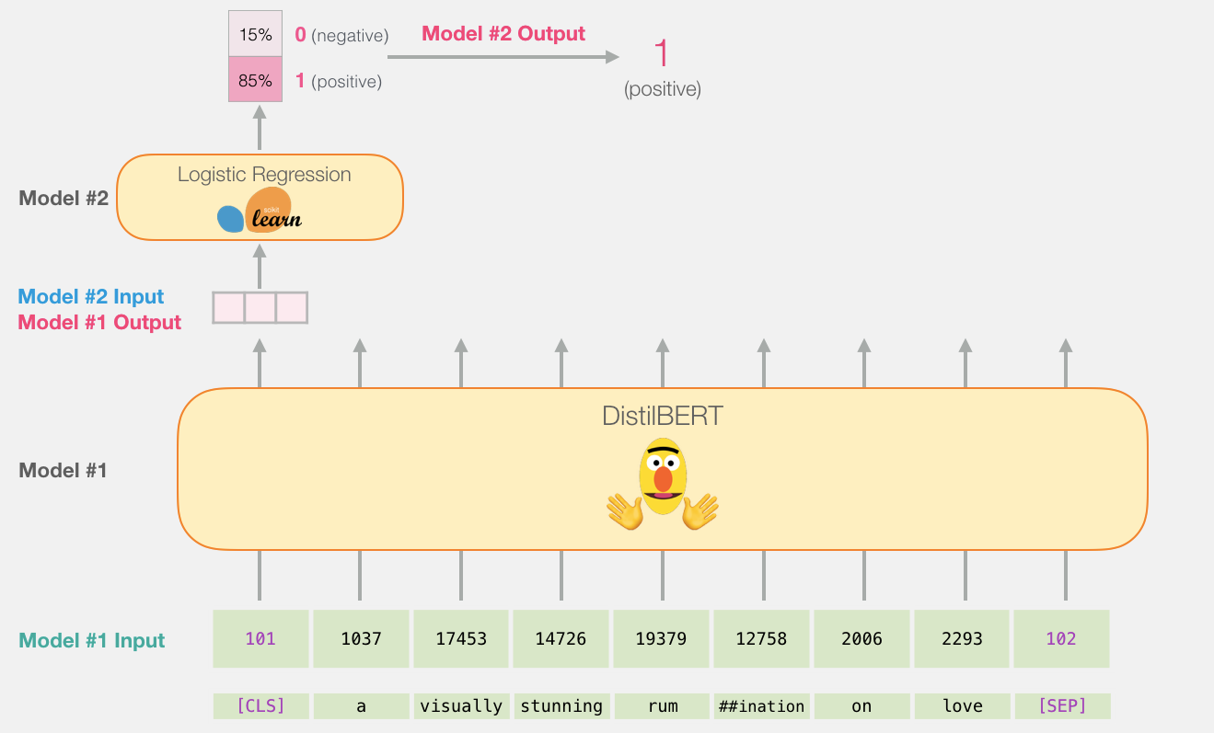
Deep Learning Model Used
Bert Text Classifier

Slide 9
EVALUTION METRIC
Primary Evaluation Metric Accuracy: Measures the proportion of correct predictions for the binary classification task.
Justification
Balanced dataset ensures impartial assessment.
False Negatives (model predicts human, but it's AI) could allow AI-generated content to be falsely accepted as human work, undermining academic integrity.
False Positives (model predicts AI, but it's human) could unjustly penalize honest students, questioning their authenticity.
Therefore, accuracy is crucial as it reflects the model's overall correctness in identifying both human and AI contributions, minimizing both FN and FP errors.

Slide 10
MODEL RESULTS
Performance Metrics:
BERT model with a 20% dropout equals the performance of the base BERT model but we will pick the BERT model with dropout implemented as the best model.
Metric to consider: accuracy.
Key Findings:
Dropout enhances the model's ability to generalize and prevents overfitting.

Slide 11
RECOMMENDATION FOR BUSINESS PROBLEM
Market the BERT classifier as a leading solution for maintaining academic integrity in the face of advancing AI text generation.
Provide educational institutions with data and case studies that demonstrate the effectiveness of the BERT classifier in real-world scenarios.
Invest in public relations and educational campaigns to raise awareness about the importance of authentic student work and the role AI can play in supporting this.

Slide 12
TEAM CONTRIBUTION
Name | Contribution
Venkata Sai Gagan Deep Alusuri | Data Extraction and Data Preprocessing involving structing the data from Redditt and ChatGPT.
Sri Kumar Dundigalla | Data Extraction and responsible for getting AI responses for the questions from OpenAI API.
Penchala Akshay Kumar Kandagaddala | Data Extraction and worked on implementing the BERT Model without dropout.
Shashank Rao Gujja | Data Extraction and worked on the implementing the BERT model with dropout.
Venkata Satya Naveen Nagulapalli | Data Extraction and worked on the ‘Question or Statement’ classifier.

Slide 13
FUTURE SCOPE
Dataset Expansion: Incorporate a wider array of sources for richer diversity.
Model Exploration: Explore alternative deep learning architectures (GPT-3, transformers) for enhanced generalization.
Practical Applications: Implement the methodology in educational institutions and email systems.

Slide 14
Thank you

